Slide 1
Data4Water Summer school on Intelligent Metering and Big Data in Hydroinformatics,
Bucharest, June 20 – July 8, 2016
DEVELOPMENT OF A SENSITIVITY ANALYSIS APPLICATION FOR AN EVENT-BASED HEC‒HMS RAINFALL-RUNOFF MODEL
BUILDING AND RUNNING THE HYDROLOGICAL MODEL

Slide 2
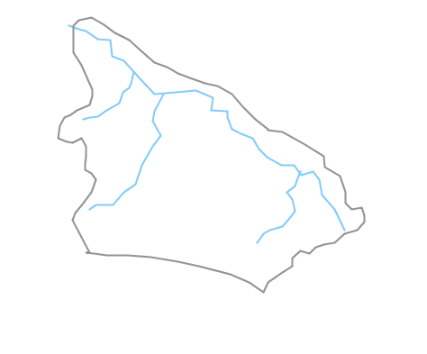
Data4Water Summer school on Intelligent Metering and Big Data in Hydroinformatics,
Bucharest, June 20 – July 8, 2016
HYDROLOGICAL MODELING
MODEL COMPONENTS
SIRON
BASIN MODEL
SIRON
METEO MODEL
SIRON
CONTROL
SIRON
TIME SERIES
Hydrological modeling – simulate the precipitation – runoff of watershed
Simulation options:
Event modeling (Initial constant, SCS Curve Number, Exponential, Green & Ampt, Smith Parlange)
Continuous modeling (one-layer deficit constant method, three-layer soil moisture accounting method)
Objective:
Building a model to simulate a storm event on Siron river basin
Model requirements:
State variables
Parameters
Boundary conditions
Initial conditions
Siron basin

Slide 3
Data4Water Summer school on Intelligent Metering and Big Data in Hydroinformatics,
Bucharest, June 20 – July 8, 2016
HYDROLOGICAL MODELLING
MODEL COMPONENTS
SIRON
BASIN MODEL
SIRON
METEO MODEL
SIRON
CONTROL
SIRON
TIME SERIES
Basin Model
Uses time series data and specific sets of parameters to represent the hydrologic system
Contains multiple methods to simulate each hydrological processes: runoff volume = loss (infiltration-saturation-runoff)
direct runoff = transform (effective rainfall-runoff)
baseflow
Meteorological Model
Defines the gage data input that is transformed during the simulation into effective precipitation, cumulated precipitation per time step, precipitation excess etc.
Can use various meteorological parameters (air temperatures, air humidity etc.) to simulate snowmelt and evapotranspiration
Control specifications
Sets the time interval of the simulation
Includes the time step for the computation
Time series data
Manually or read from file time series data; gridded data; paired data
entered manually or automatically (HEC-DSS).

Slide 4
Data4Water Summer school on Intelligent Metering and Big Data in Hydroinformatics,
Bucharest, June 20 – July 8, 2016
HYDROLOGICAL MODELLING
MODEL COMPONENTS
SIRON
BASIN MODEL
SIRON
METEO MODEL
SIRON
CONTROL
SIRON
TIME SERIES
Loss → SCS Curve Number Method - implements curve number methodology for incremental losses (NRCS,2007)
Parameters needed:
Initial Abstraction (m³/s): amount of precipitation that must infiltrate before surface excess results
Curve number: - expresses the runoff potential and it is dependent on soil permeability, land coverage, basin area
- the range for CN values is 0 – 100 without ever reaching to the extreme values
CN = 0 → the entire amount of precipitation infiltrates = low runoff potential
CN = 100 → impervious soils = high runoff potential
Impervious (%): the share of the basin area that is impervious
- all precipitation becomes direct runoff

Slide 5
Data4Water Summer school on Intelligent Metering and Big Data in Hydroinformatics,
Bucharest, June 20 – July 8, 2016
HYDROLOGICAL MODELLING
MODEL COMPONENTS
SIRON
BASIN MODEL
SIRON
METEO MODEL
SIRON
CONTROL
SIRON
TIME SERIES
Transform → Snyder Unit Hydrograph – calculates the unit hydrograph through Snyder’s method
Parameters needed:
Standard Lag (hr): time between the centroid of excess rainfall and the centroid of the resulting hydrograph
depends on: basin area, slope, river network length, curve number
$t_{lag}=\frac{{\left(L∙3,28∙{10}^{3}\right)}^{0.8}∙{\left(\frac{1000}{CN}−9\right)}^{0,7}}{\left(1900∙Y^{0,5}\right)}$ , where:
$t_{lag}=lag time$,$CN =curve number$, $Y =slope$, $L =river network length$
GIS → basin area, slope, river length network
Peaking Coefficient: steepness of the hydrograph that results from a unit of precipitation

Slide 6
Data4Water Summer school on Intelligent Metering and Big Data in Hydroinformatics,
Bucharest, June 20 – July 8, 2016
HYDROLOGICAL MODELLING
MODEL COMPONENTS
SIRON
BASIN MODEL
SIRON
METEO MODEL
SIRON
CONTROL
SIRON
TIME SERIES
Baseflow → Exponential recession
Parameters needed:
Initial Discharge (m³/s): the initial value from which the baseflow for each time step is calculated
Recession Constant: defined as the ratio of present baseflow value at previous time step baseflow
Threshold Type: discharge value at which all runoff is considered baseflow; if Ratio to Peak is chosen, the threshold is dependent on the peak value (not a fixed discharge value)

Slide 7
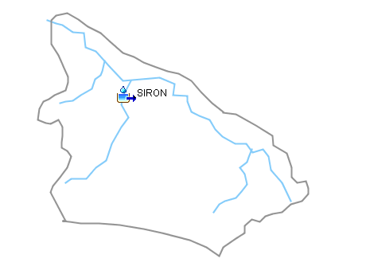
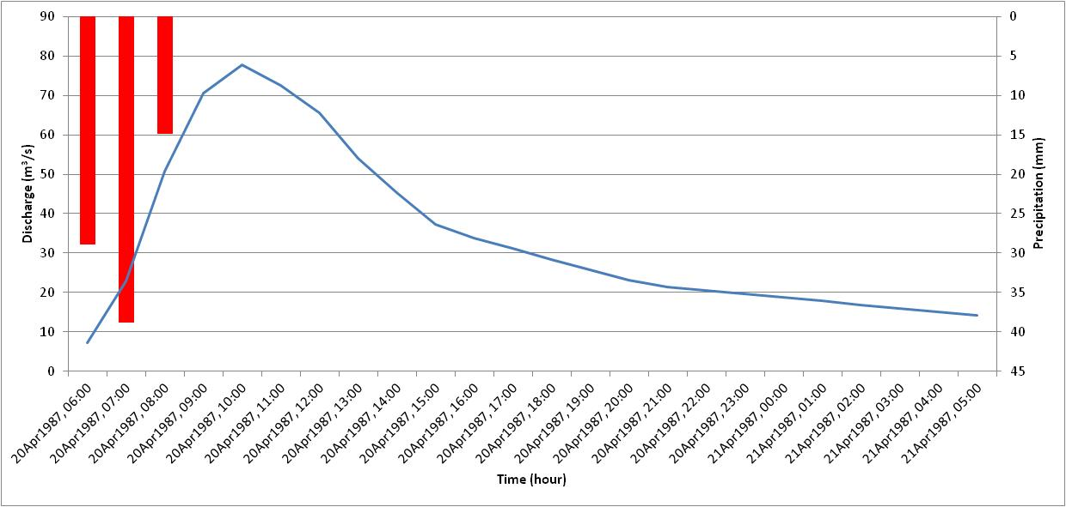
Data4Water Summer school on Intelligent Metering and Big Data in Hydroinformatics,
Bucharest, June 20 – July 8, 2016
HYDROLOGICAL MODELLING
MODEL COMPONENTS
SIRON
BASIN MODEL
SIRON
METEO MODEL
SIRON
CONTROL
SIRON
TIME SERIES
Meteorological model:
Gage Weights → specify the weights
to defined precipitation gages (in our
study case just one precipitation gage was used)
Control data:
START DATE and TIME: dd.mm.yyyy hh:mm
END DATE and TIME: dd.mm.yyyy hh:mm
COMPUTATION TIME STEP: 1 minute → 1 Day (1 hour in our case study)
Time series data:
Precipitation (mm)
Discharge (m³/s)

Slide 8
Thank you!

