Slide 1
HEC-HMSens
Elena Ruth Perju
George Tudor
Lucian Umbrarescu

Slide 2
Why HEC-HMSens ?
We tried to find an intuitive name for our App and HEC-HMSens stands for HEC-HMS Sensitivity
Our application is a good tool for perfoming Sensitivity Analysis in order to compair results and to estimate better values for the parameters

Slide 3
Design and GUI
The GUI consists of :
Four sliders for varying the parameters (SSC Curve Number, Snyder Lag Number and Recession Constant together with the precipitation percentage)
Three check boxes
Two plots (Hyetograph and Hydrograph)
The START button

Slide 4
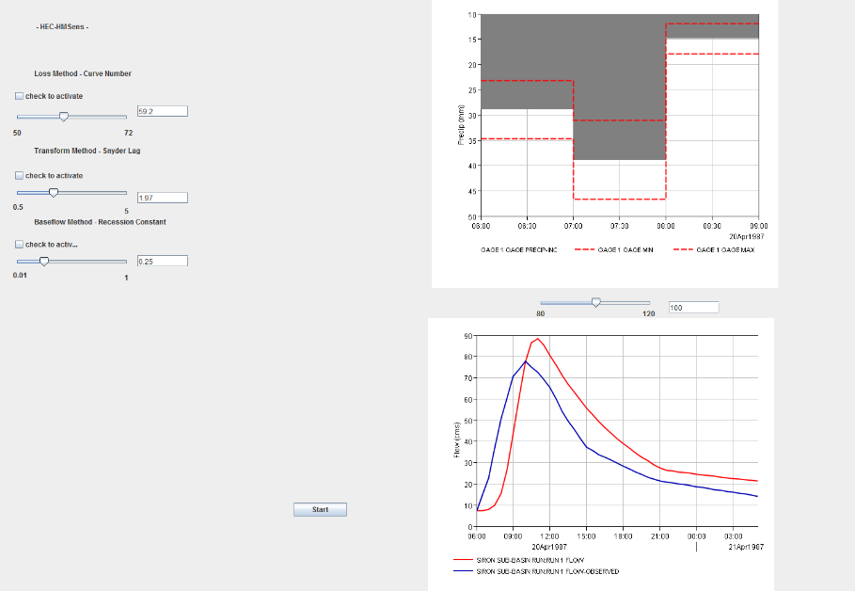
The Graphical User Interface

Slide 5
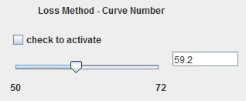
Design and GUI (2)
Additional to the slider bars we added text boxes to make it easier for the user to introduce a precise number if needed

Slide 6
Design and GUI (3)
It is developed using Java Programming Language due to the OOP combined with the graphical design facilities
Our application runs scripts (batch files that launch Jython scripts written in HEC-DSS’s Editor and CMD executables) to automate the process of launching HEC-HMS, running the Simulation Model or overwriting data

Slide 7
Design and GUI (4)
HEC-HMSens is USER-FRIENDLY, every time a value outside the range is introduced it pops up a window to indicate this error.

Slide 8
Functionality
The steps that define the background functionality are as follows:
START button triggers the beginning of the background execution

Slide 9
2. The program overwrites the new values of the parameters in the Siron.basin file and it writes the new value of Precipitation in Run_1.dss file
3. HEC-HMS is launched and Computes Run1 Simulation
4. Two Jython scripts create two plots based on the information provided from the Run1 Simulation being brought in GUI

Slide 10
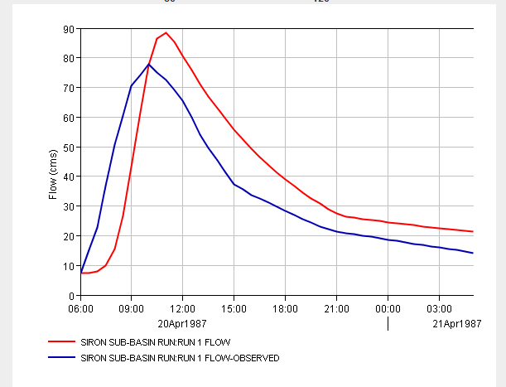
Hydrograph

Slide 11
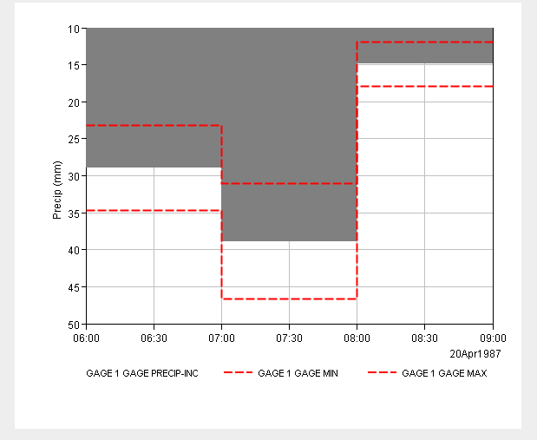
Hyetograph

Slide 12
Advantages
HEC-HMSens is very useful and easy to work with
It brings together programming, scripting, plots to create a tool good for professional Hydrological Analysis
It is simple (yet available for improving) and ready to use

Slide 13
Disavantages
HEC-HMSens depends very much on naming directories and files in a certain way.
Not (yet) available on other OS

Slide 14
Summer School Thoughts
Ruth:
“The summer school was an opportunity to learn new things in the hydrological modelling domain and I trully hope that we will work together again”

Slide 15
Summer School Thoughts
George:
“I am glad I had the chance to be involved in the Hydroinformatics Summer School. Here we all worked together and I also could test my programming abilities. It was a great thing for me and an opportunity.”

Slide 16
Summer School Thoughts
Lucian:
“I am very glad I have been part of this Summer School. Being able to meet specialists in this area of Hydrology and working together to achieve something useful for both sides was such an experience. I would like to thank my teammates who are very kind and professional people and also to the entire collective both proffesors and team-involved persons. Working with them and sharing ideas is such a treassure for my mind and heart.”

Slide 17
Thank you !
We welcome any questions

