Slide 1
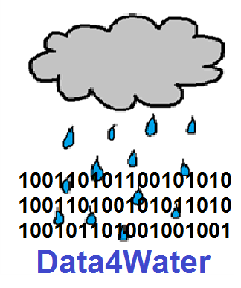
Smart Data and Services for Supporting Water Management
Data4Water

Slide 2
Data4Water Project Presentation
Context of the project
The importance of the research field
Consortium
Objectives
Work packages
Outputs and outcomes

Slide 3
H2020-TWINN-2015
The specific challenge is to address networking gaps and deficiencies between the research institutions of the low performing Member States and regions and internationally-leading counterparts at EU level.
Scope: Twinning aims at significantly strengthening a defined field of research in a particular knowledge institution (a research active university or a public or private non-profit research organisation) by creating a link between this institution and at least two internationally-leading research institutions in other Member States.

Slide 4
H2020-TWINN-2015
The applicant organisation should be established in a Member State that is ranked below 70% of the EU27 average of the composite indicator on Research Excellence or Associated Country, subject to the future association agreements of third countries with Horizon 2020:
Bulgaria, Croatia, Cyprus, Czech Republic, Estonia, Hungary, Latvia, Lithuania, Luxembourg, Malta, Poland, Portugal, Romania, Slovakia and Slovenia

Slide 5
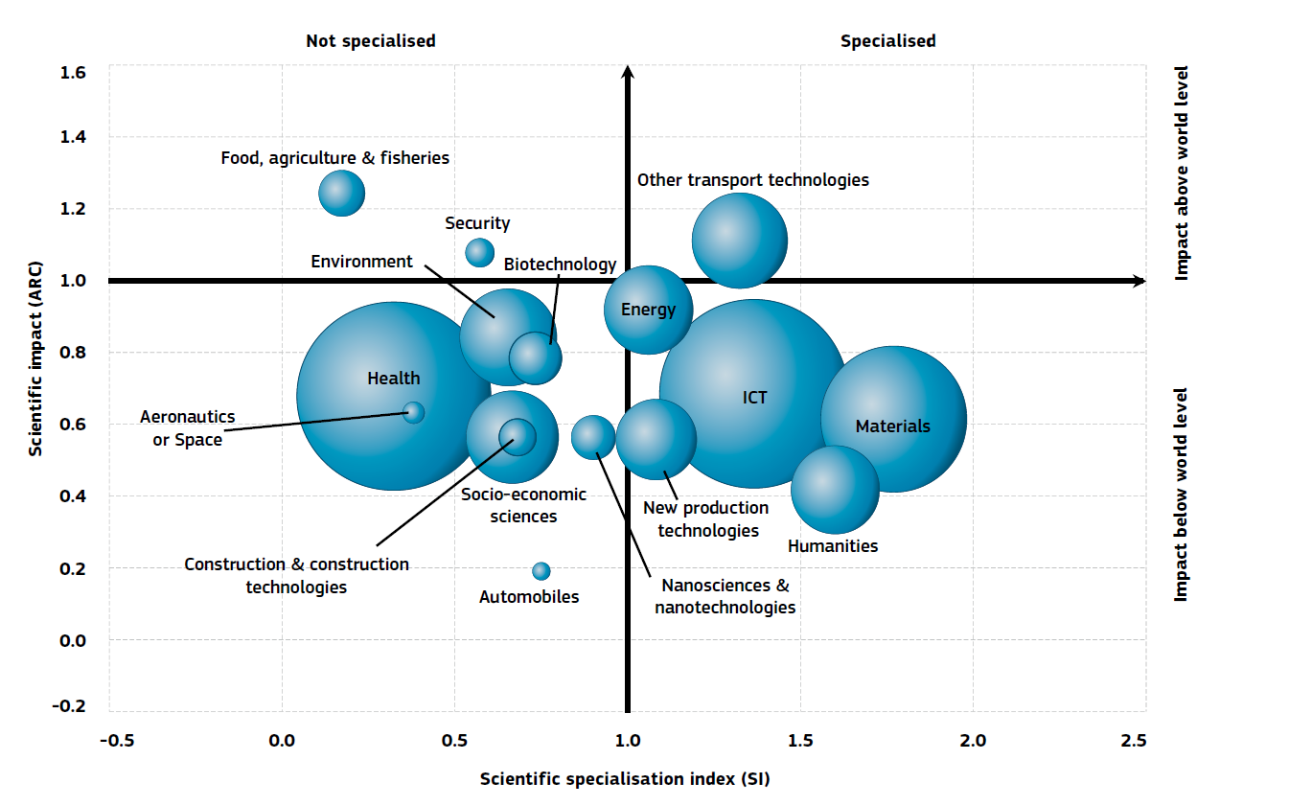
Romania – Positional analysis of publications in Scopus, 2000–2010

Slide 6
Key indicators
Key indicator | Rank within EU (from 28 countries)
Knowledge-intensive services exports as % total service exports | 7
Share of renewable energy in gross final energy consumption | 8
New doctoral graduates per thousand population | 13
License and patent revenues from abroad | 13

Slide 7
Research and Innovation indicators for UPB SCIMAGO characterization of institutions
Indicator | Description | Place in Ro | Place international
Output | Total number of documents published in scholarly journals indexed in Scopus | 1 | 517
Scientific talent pool | Total number of authors from an institution in the total publication output of that institution during a particular period of time. | 1 | 692
Specialization Index | The Specialization Index indicates the extent of thematic concentration /dispersion of an institution’s scientific output. Values range between 0 and 1, indicating generalist vs. specialized institutions respectively. | 5 | 2069
International Collaboration | Institution's output ratio produced in collaboration with foreign institutions. The values are computed by analyzing an institution's output whose affiliations include more than one country address | 5 | 2122

Slide 8
Research and Innovation indicators for UPB SCIMAGO characterization of institutions
Indicator | Description | Place in Ro | Place international
Normalized Impact | Normalized Impact of led output is computed using the methodology established by the Karolinska Institutet in Sweden where it is named "Item oriented field normalized citation score average". | 8 | 4839
Excellence with Leadership | Excellence with Leadership indicates the amount of documents in the Excellence rate in which the institution is the main contributor | 9 | 996
Scientific Leadership | Leadership indicates the percentage of an institution’s output as main contributor, that is, the amount of papers in which the corresponding author belongs to the institution | 10 | 489
High Quality Publications | Ratio of publications that an institution publishes in the most influential scholarly journals of the world, those ranked in the first quartile (25%) in their categories as ordered by SCImago Journal Rank (SJRII) indicator | 10 | 4539

Slide 9
Data4Water Project Presentation
Context of the project
The importance of the research field
Consortium
Objectives
Work packages
Outputs and outcomes

Slide 10
The importance of the research field
Schematic of the hydrologic cycle
Source: WATERS (2008) Water and Environmental Research Systems Network, Science Plan, National Science Foundation, Reston, VA, USA

Slide 11
Technological achievements over time
Elaborated from “Emerging topics and technology roadmap for Information and Communication Technologies for Water Management - ICT for Water Management Roadmap”, EUROPEAN COMMISSION, Directorate-General for Communications Networks, Content and Technology Smart Cities and Sustainability unit

Slide 12
Smart Specialisation Strategy of Romania
BIOECONOMY;
ICT;
Analysis, management and security of big data
Future internet
Software development technologies, instruments, and methods
High performance computing and new computational models
ENERGY AND ENVIRONMENT;
Increasing end-use energy efficiency
Optimizing the use of conventional and non-conventional water resources
The intelligent city
ECO-TECHNOLOGIES.

Slide 13
Data4Water Project Presentation
Context of the project
The importance of the research field
Consortium
Objectives
Work packages
Outputs and outcomes

Slide 14
Project partners
UNIVERSITY POLITEHNICA FROM BUCHAREST, Romania
UNIVERSITA' DEGLI STUDI DI MILANO-BICOCCA, Italy
Fraunhofer-Gesellschaft zur Förderung der angewandten Forschung e.V., FRAUNHOFER INSTITUTE FOR OPEN COMMUNICATION SYSTEMS
Stichting IHE (UNESCO-IHE), Delft Netherlands

Slide 15
Data4Water Project Presentation
Context of the project
The importance of the research field
Consortium
Objectives
Work packages
Outputs and outcomes

Slide 16
Overall objective
to strengthen research in the field of smart data driven e-services in water resources management, made available to international community and/or specific stakeholders such as companies, citizens, and authorities

Slide 17
Specific objectives
Enhance the science and technology (S&T) capacity of the participating institutions
Raise staff’s research profile as well as the one of the institutions involved
Contribute to the overall Smart Specialisation Strategy
Contribute to the development of a new, interdisciplinary research domain - Hydroinformatics
Include the Romanian organization as an active member of the research networks of the internationally-leading research partner institutions

Slide 18
Project overview
Increase of scientific results
Roadmap
RQAS
Research framework
Knowledge Lake
Enhancement of scientific competences
Enhancement of organizational capability
Training
Summer school
Staff exchange
Conference
Workshop
Training
Networking

Slide 19
Data4Water Project Presentation
Context of the project
The importance of the research field
Consortium
Objectives
Work packages
Outputs and outcomes

Slide 20
Overall structure of the work plan
WP1
Development of the framework for scientific strategy enforcement
WP5
Dissemination of Project Outcomes
WP3
Training
WP6
Project management
WP4
Organization of scientific events
WP2
Partnership and networking

Slide 21
WP1 - Development of the framework for scientific strategy enforcement
WP leader: UPB
Objectives:
Develop and implement a suitable, stable and sustainable framework for the scientific strategy enforcement in the research field of value added, data driven e-services in water management;
Develop a Research Quality Assurance System (RQAS) that will allow benchmarks’ setup for increasing the Composite Research Indicator and monitor its evolution in time

Slide 22
WP1 - Development of the framework for scientific strategy enforcement
Tasks:
T1.1 Develop a framework for implementing the scientific strategy
T.1.2 Develop the RQAS
T1.3 Update the Participant Portal
Deliverables:
Technology survey: Prospective and challenges
Roadmap of the research team in SDWM
Research QA Handbook
Statement regarding the update of the Participant Portal

Slide 23
WP2 - Partnership & networking
WP leader: FOKUS
Objectives:
WP2 aims to create a link between the Romanian research group and the internationally-leading research institutions, as well as to encourage and enhance the networking of the Romanian research group with other research intensive institutions in Europe, industry specialists, public authorities, and institutions that regulate critical resource management

Slide 24
WP2 - Partnership & networking
Tasks:
T2.1Research staff exchanges
T2.2 Develop a network of excellence and partnership in Smart Data for Water Management
Deliverables:
D2.1 Report on staff exchanges (that includes the individual reports)
D2.2 Report on the Information & Networking events

Slide 25
WP3 - Training
WP leader: UNESCO-IHE
Objectives:
The aim of this work-package is to organize trainings on topics related to excellence in research, that will be attended by target groups of the UPB
IT topics
Water management related topics
Research methods related topics

Slide 26
WP3 - Training
Tasks:
T 3.1 Short-term trainings
T 3.2 Summer schools
T 3.3 PhD short-term on-site training
Deliverables:
D 3.1 Training needs assessment report (based on a training needs survey at UPB).
D 3.2 Status report on training courses and summer schools

Slide 27
WP4 - Organization of scientific events
WP leader: UNIMIB
Objectives:
The aim of this work-package is to organize a series of high quality scientific events to facilitate knowledge transfer and raise the visibility of UPB at national and international level. The events will reunite: xperienced and young researchers from UPB, research staff from the partnering institutions, as well as invited researchers from other bodies (universities, companies) relevant to the development of the research field.

Slide 28
WP4 - Organization of scientific events
Tasks:
T4.1 Organization of workshops
T.4.2 Organization of a co-located conference
T4.3 Participation to scientific events
Deliverables:
D 4.1 Report on organization of scientific events (workshops and co-located conference)
D 4.2 Report on participation at scientific events, relevant for the research field

Slide 29
WP5 - Dissemination of Project Outcomes
WP leader: UPB
Objectives:
Promotion and dissemination activities are essential lines of actions towards achieving the project objectives. WP5 is dedicated to a series of actions that will encompass both dissemination activities of the project outcomes and results, and promotional activities of UPB excellence in research towards increasing UPB visibility at regional, European and international level.

Slide 30
WP5 - Dissemination of Project Outcomes
Tasks:
T5.1 Develop a Networking and Knowledge E-Environment, "Knowledge-lake"
T 5.2 Develop the visual identity package of the project
T 5.3 Promote UPB scientific excellence
T 5.4 Valorisation and exploitation/sustainability of project results
T5.5 Develop the project site (M1-M36)
Deliverables:
D5.1 Knowledge-lake e-platform
D5.2 Report on Dissemination and valorisation activities
D5.3 Project site

Slide 31
WP6- Project Management
WP leader: UPB
Objectives:
WP 6 is dedicated to overall co-ordination and management of the project, with the goal of ensuring overall project coherency, provide efficient management and decision making procedures, identify any problems encountered in achieving the stated project goals and put structures in place to take timely and appropriate corrective action, and finally, make a synthesis of the project results and findings.

Slide 32
WP6- Project Management
Tasks:
T 6.1: Monitoring project activities and financial management
T 6.2: Project Communication
T6.3 Liaison with Commission Services
Deliverables:
D6.1 First Project Report
D6.2 Final Project Report

Slide 33
Data4Water Project Presentation
Context of the project
The importance of the research field
Consortium
Objectives
Work packages
Outputs and outcomes

Slide 34
Outpus and outcomes
Strong partnerships
Increased visibility for UPB
Further joint projects
Development of the Roadmap for the UPB research team
Contribution to the development of Hydorinformatics
e-Knowledge and Networking Environment - "Knowledge Lake"
Development of a Research Quality Assurance Systems
Organization of international workshops
Organization of at least 6 training sessions
Organization of 3 summer schools
Exchange of researchers and PhD students
Organization of 3 information and networking events

Slide 35
Thank you for your attention
The UPB team:
Mariana MOCANU Valentin CRISTEA
Nicolae ŢĂPUŞ Ciprian DOBRE
Florin POP Elena APOSTOL
Cătălin LEORDEANU Silvia ANTON
Mihai CARABAŞ Ionela MATEI
Oana MANICA Fănel GHIŢĂ

